Slide 1
THE MOST COMMON PHOBIAS & FEARS

Slide 2

Acrophobia
Acrophobia is the fear of heights

Slide 3

Aerophobia
Aerophobia is the fear of flying

Slide 4
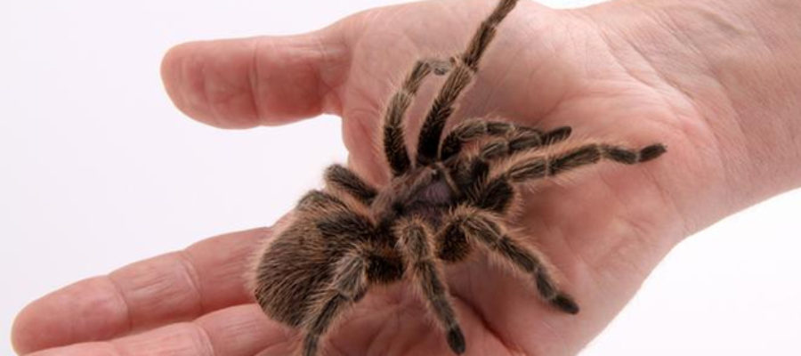
Arachnophobia
Arachnophobia is the fear of spiders and other arachnids

Slide 5
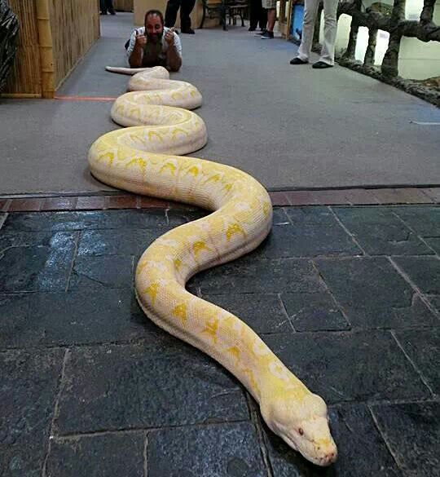
Ophidiophobia
Ophidiophobia is the fear of snakes

Slide 6
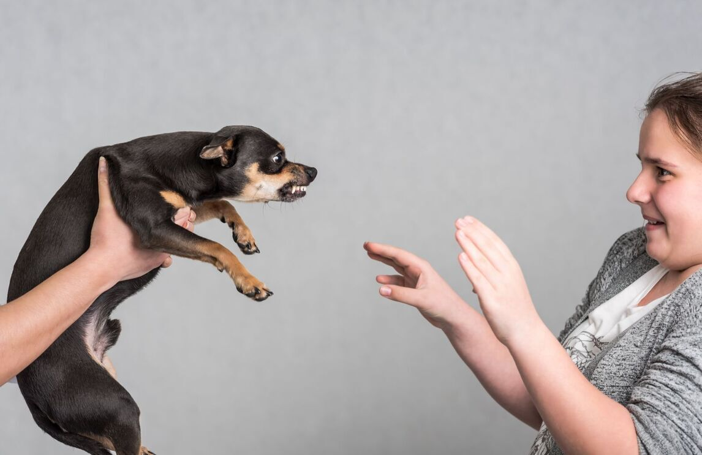
Cynophobia
Cynophobia is the fear of dogs

Slide 7

Trypanophobia
Trypanophobia is the fear of injections

Slide 8

Astraphobia
Astraphobia is the fear of thunder and lighting

Slide 9

Agoraphobia
Agoraphobia is the fear of being alone in a situation or place where escape might be difficult

Slide 10
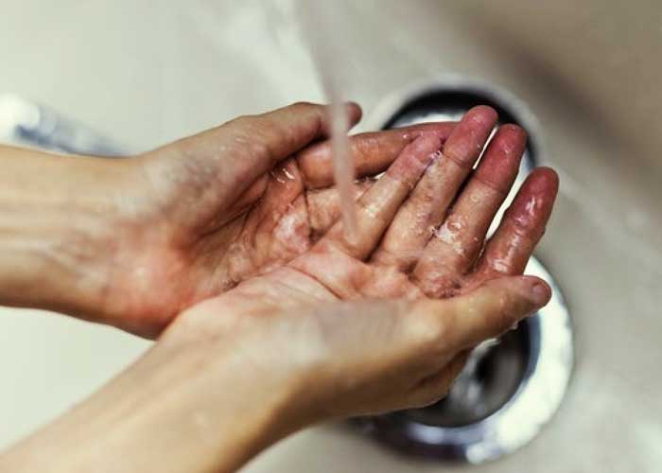
Mysophobia
Mysophobia is the excessive fear of germs and dirts

Slide 11

Social phobia
Social phobia is the fear of social situations

